Slide 1
Carbon inputs to terrestrial ecosystems

Slide 2
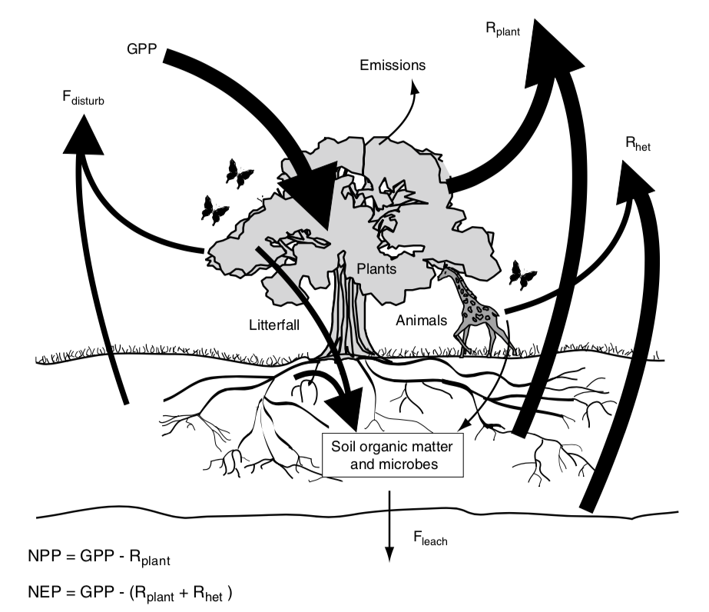
Terrestrial Ecosystem Carbon Cycle

Slide 3
Terrestrial Ecosystem Carbon Cycle
Arrows represent fluxes
How do these compare to anthropogenic carbon fluxes?

Slide 4
Data from IPCC (2013)

Slide 5
1 acre corn plot takes up > 5000 lbs of CO₂ a year

Slide 6
Terrestrial Ecosystem Carbon Cycle

Slide 7
NPP = GPP - R_{plant}

Slide 8
NPP = GPP - R_{plant}
Net Primary Productivity (C into plants – C out of plants; per ground area)

Slide 9
NPP = GPP - R_{plant}
Gross Primary Productivity (total flux of C into plants; per ground area)

Slide 10
NPP = GPP - R_{plant}
Plant Respiration (total flux of C out of plants ; per ground area)

Slide 11
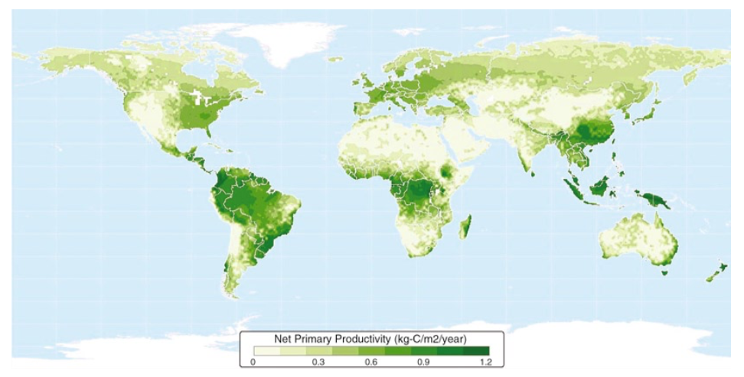
What patterns do you see?

Slide 12
NPP = GPP - R_{plant}
Gross Primary Productivity (total flux of C into plants; per ground area)

Slide 13
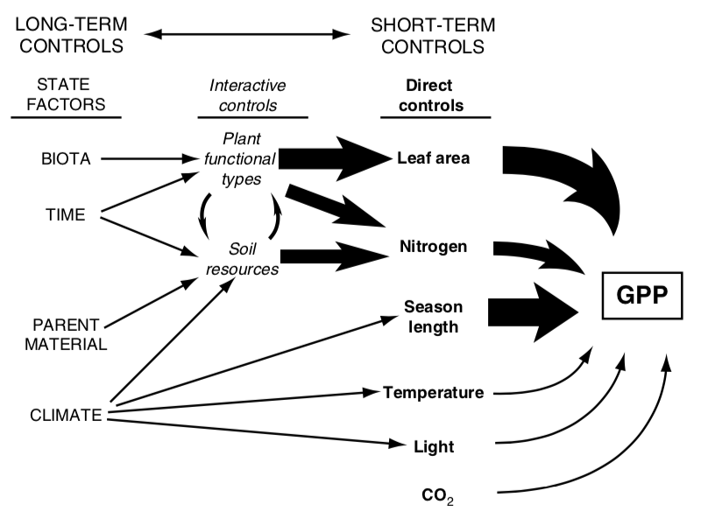

Slide 14
GPP = photosynthesis * LAI

Slide 15
GPP = photosynthesis * LAI
Carbon in to leaves (per leaf area)

Slide 16
GPP = photosynthesis * LAI
Leaf area index (leaf area per ground area)

Slide 17
GPP = photosynthesis * LAI
Carbon in to leaves (per leaf area)

Slide 18
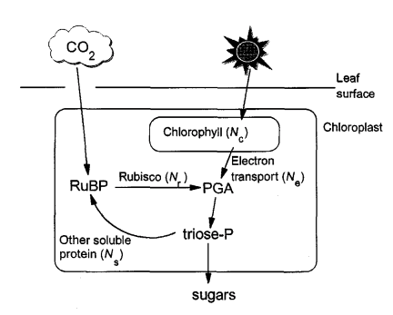
Simple recap of photosynthesis
Medlyn 1996

Slide 19
Simple recap of photosynthesis
Medlyn 1996

Slide 20
Photorespiration
Rubisco : RibUlose – 1,5 – BISphosphate Carboxylase and Oxygenase
Catalyzes CO₂ and O₂
Catalyzing O₂ leads to “wasteful” respiration (loss of CO₂)
Increases as O₂ increases
Increases with temperature

Slide 21
3 types of photosynthesis systems
C₃: what we already covered
Most plants
C₄: Separate carbon acquisition and sugar creation in space
Typically grasses
CAM: Separate carbon acquisition and sugar creation in time
E.g., Cacti

Slide 22
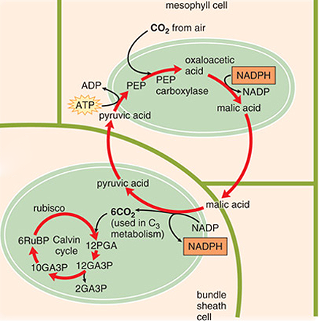
C4 photosynthesis
PEP carboxylase captures CO₂ and creates a 4 carbon sugar in mesophyll
Moves sugar to bundle sheath, where CO2 is removed
Bundle sheath cells surround veins
Calvin cycle progresses as normal
“Costs” two extra ATPs

Slide 23
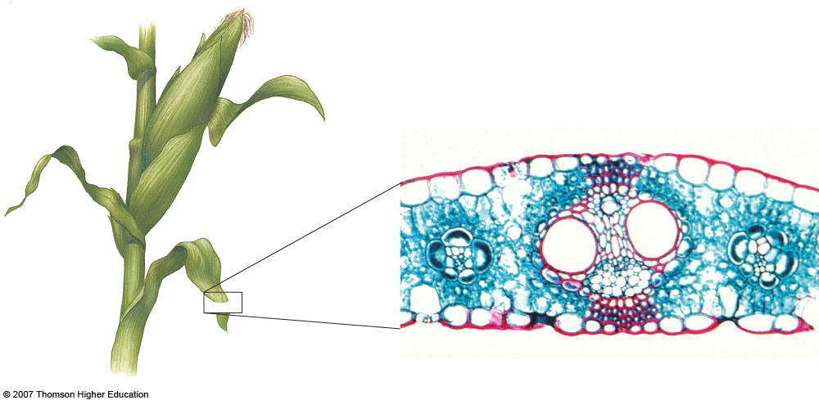
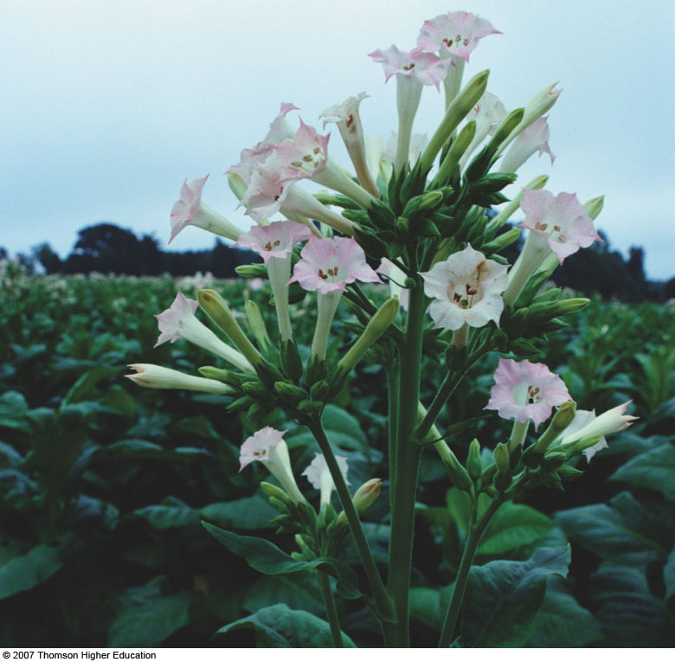
C4 photosynthesis – why the bundle sheath?
Bundle sheath cells
Midvein
Parallel vein
Mesophyll
Upper epidermis
Lower epidermis
Phloem
Xylem

Slide 24
C4 photosynthesis - benefits
PEP carboxylase is not an oxygenase
Good at capturing CO2
Good in low CO2 environments
Good in hot, dry environments
Can close stomata

Slide 25
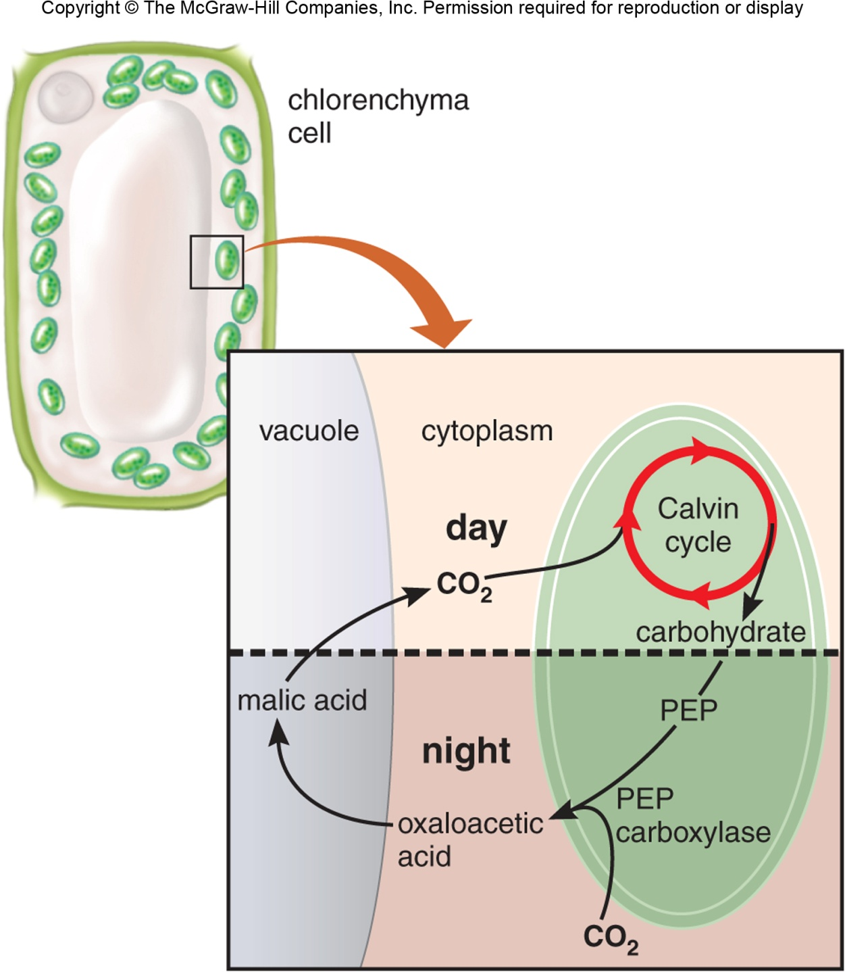
CAM photosynthesis
Opens stomata during the night
PEP carboxylase captures CO₂ and creates a 4 carbon sugar
Closes stomata during the day
Calvin cycle

Slide 26
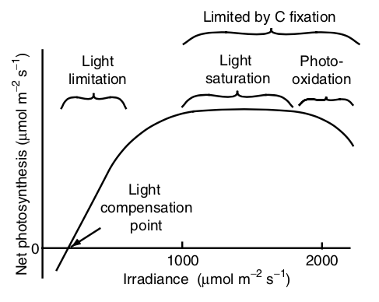
Environmental responses - light

Slide 27
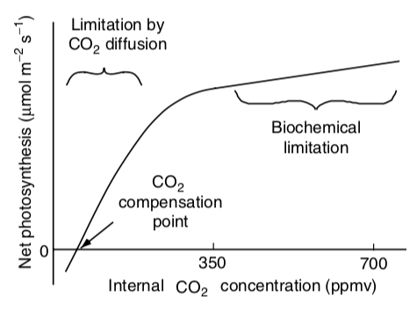
Environmental responses – CO₂

Slide 28
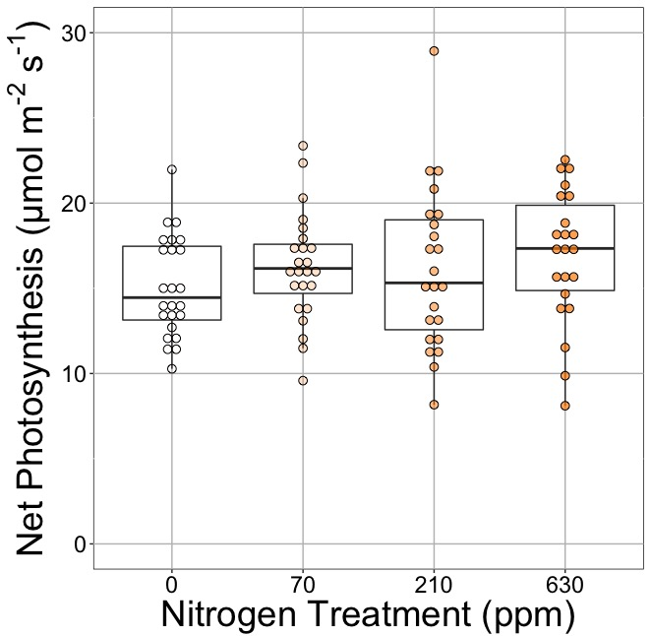
Photosynthesis is less responsive to soil resources (water and nutrients). Why?
Waring et al. (2023)

Slide 29
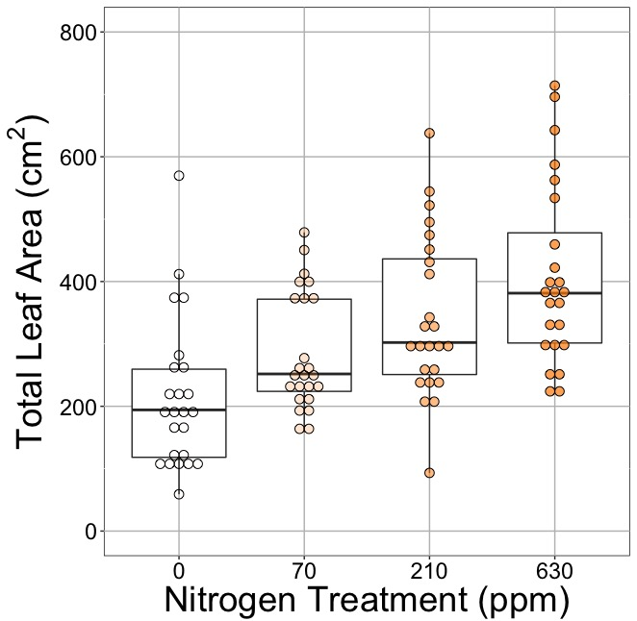
Photosynthesis is less responsive to soil resources (water and nutrients). Why?
Waring et al. (2023)

Slide 30
GPP = photosynthesis * LAI
Leaf area index (leaf area per ground area)

Slide 31
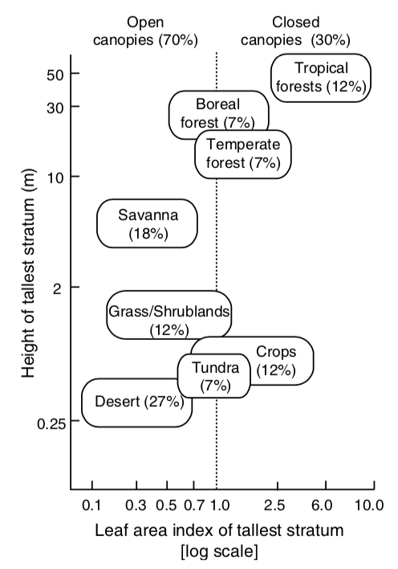
What’s driving the x-axis distribution?
Figure 5.20 from book

Slide 32
What’s driving the y-axis distribution?
Figure 5.20 from book

Slide 33
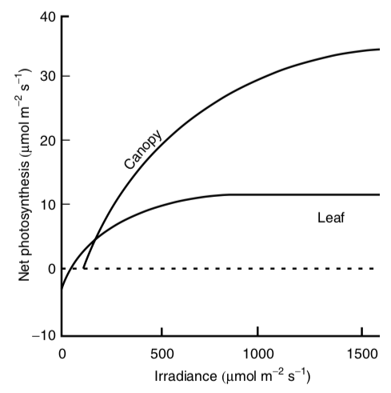
Canopies tend to have higher light use efficiency than leaves

Slide 34
NPP = GPP - R_{plant}
Plant Respiration (total flux of C out of plants ; per ground area)

Slide 35
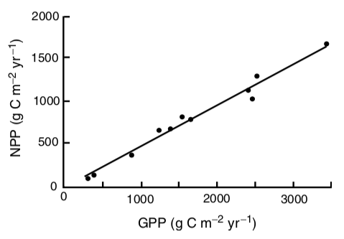
NPP = GPP – 0.47*GPP
Originally proposed by Waring (1998)

Slide 36
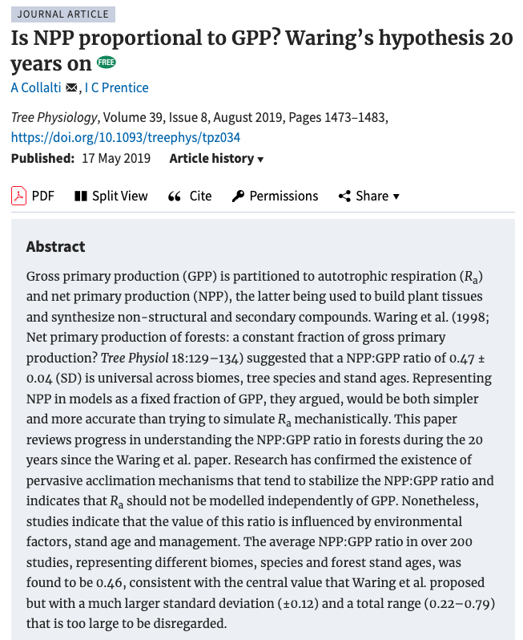

Slide 37
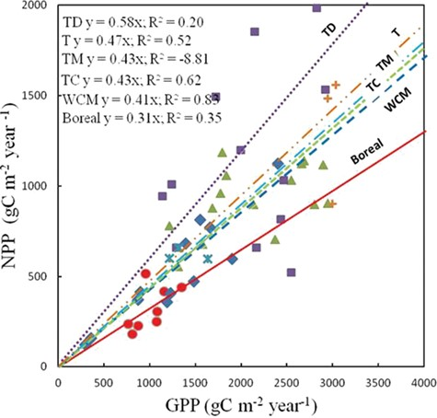
NPP – GPP relationship varies slightly by biome
Collalti and Prentice (2019)

Slide 38
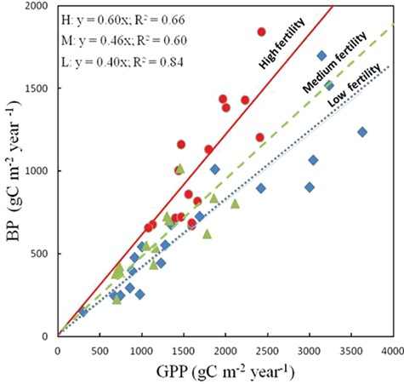
NPP – GPP relationship varies slightly by soil resources
Collalti and Prentice (2019)

Slide 39
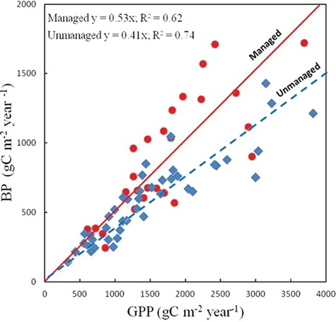
NPP – GPP relationship varies slightly by management
Collalti and Prentice (2019)

Slide 40
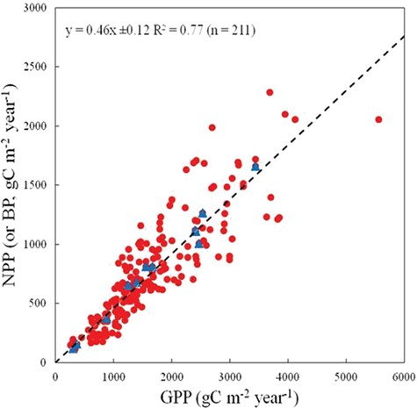
With more data, the relationship on average is still close to Waring’s
Collalti and Prentice (2019)

Slide 41
What drives NPP?
Over short time scales (seconds to days)
Photosynthesis
Light, temperature, atmospheric conditions
Over long time scales (weeks to months)
LAI
Growth demand
Management
Soil resources

Slide 42
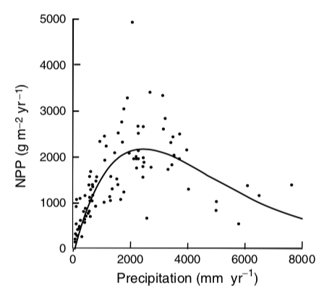
Figure 6.3 from book

Slide 43
Figure 6.3 from book

